Slide 1
Wellness
Core Workshop 2015
Notes:
Insert music loop for workshop
Welcome guests

Slide 2
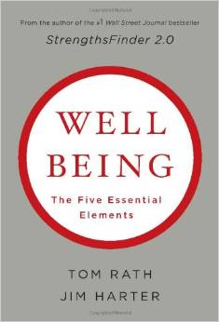
2015 Core Workshop
Notes:
Formal welcome, introduce yourselves. Explain the workshop’s purpose & objective of this workshop

Slide 3
Notes:
INTRODUCTION ACTIVITY:

Slide 4
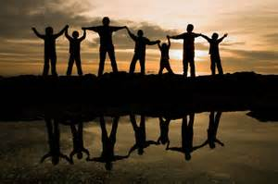
Social
Close relationships are good for your physical & emotional wellbeing

Slide 5
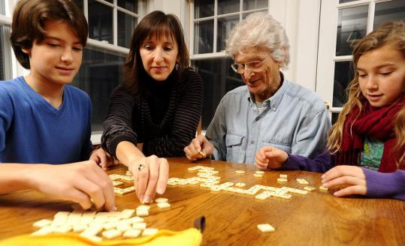
Social
Nurture relationships everywhere

Slide 6
Social
Socialize all day long

Slide 7
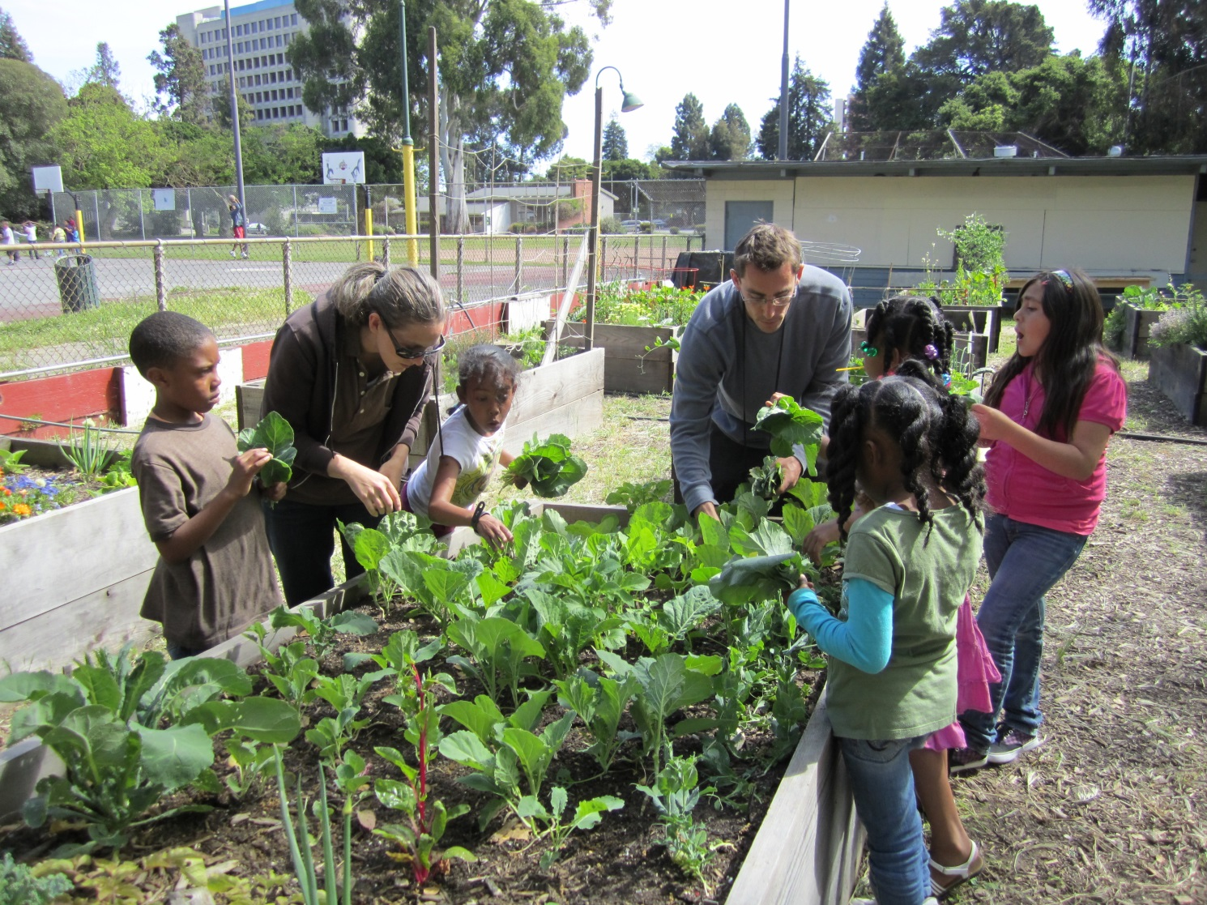
Social
Be active & social

Slide 8
Career

Slide 9
Career
Foster everyone's strengths

Slide 10
Career
Keep a balance between work and personal life

Slide 11
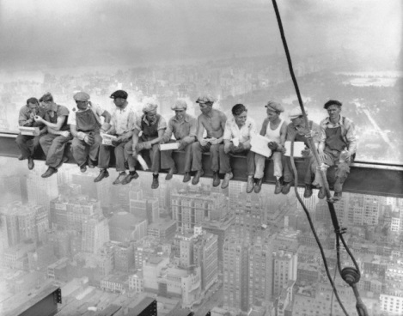
Career
Relationships at work are critical to your wellbeing

Slide 12
Activity
“How can the college through its processes, procedures, trainings or systems support and improve our social or career wellbeing?”
Notes:
Formal welcome, introduce yourselves. Explain the workshop’s purpose & objective of this workshop

Slide 13
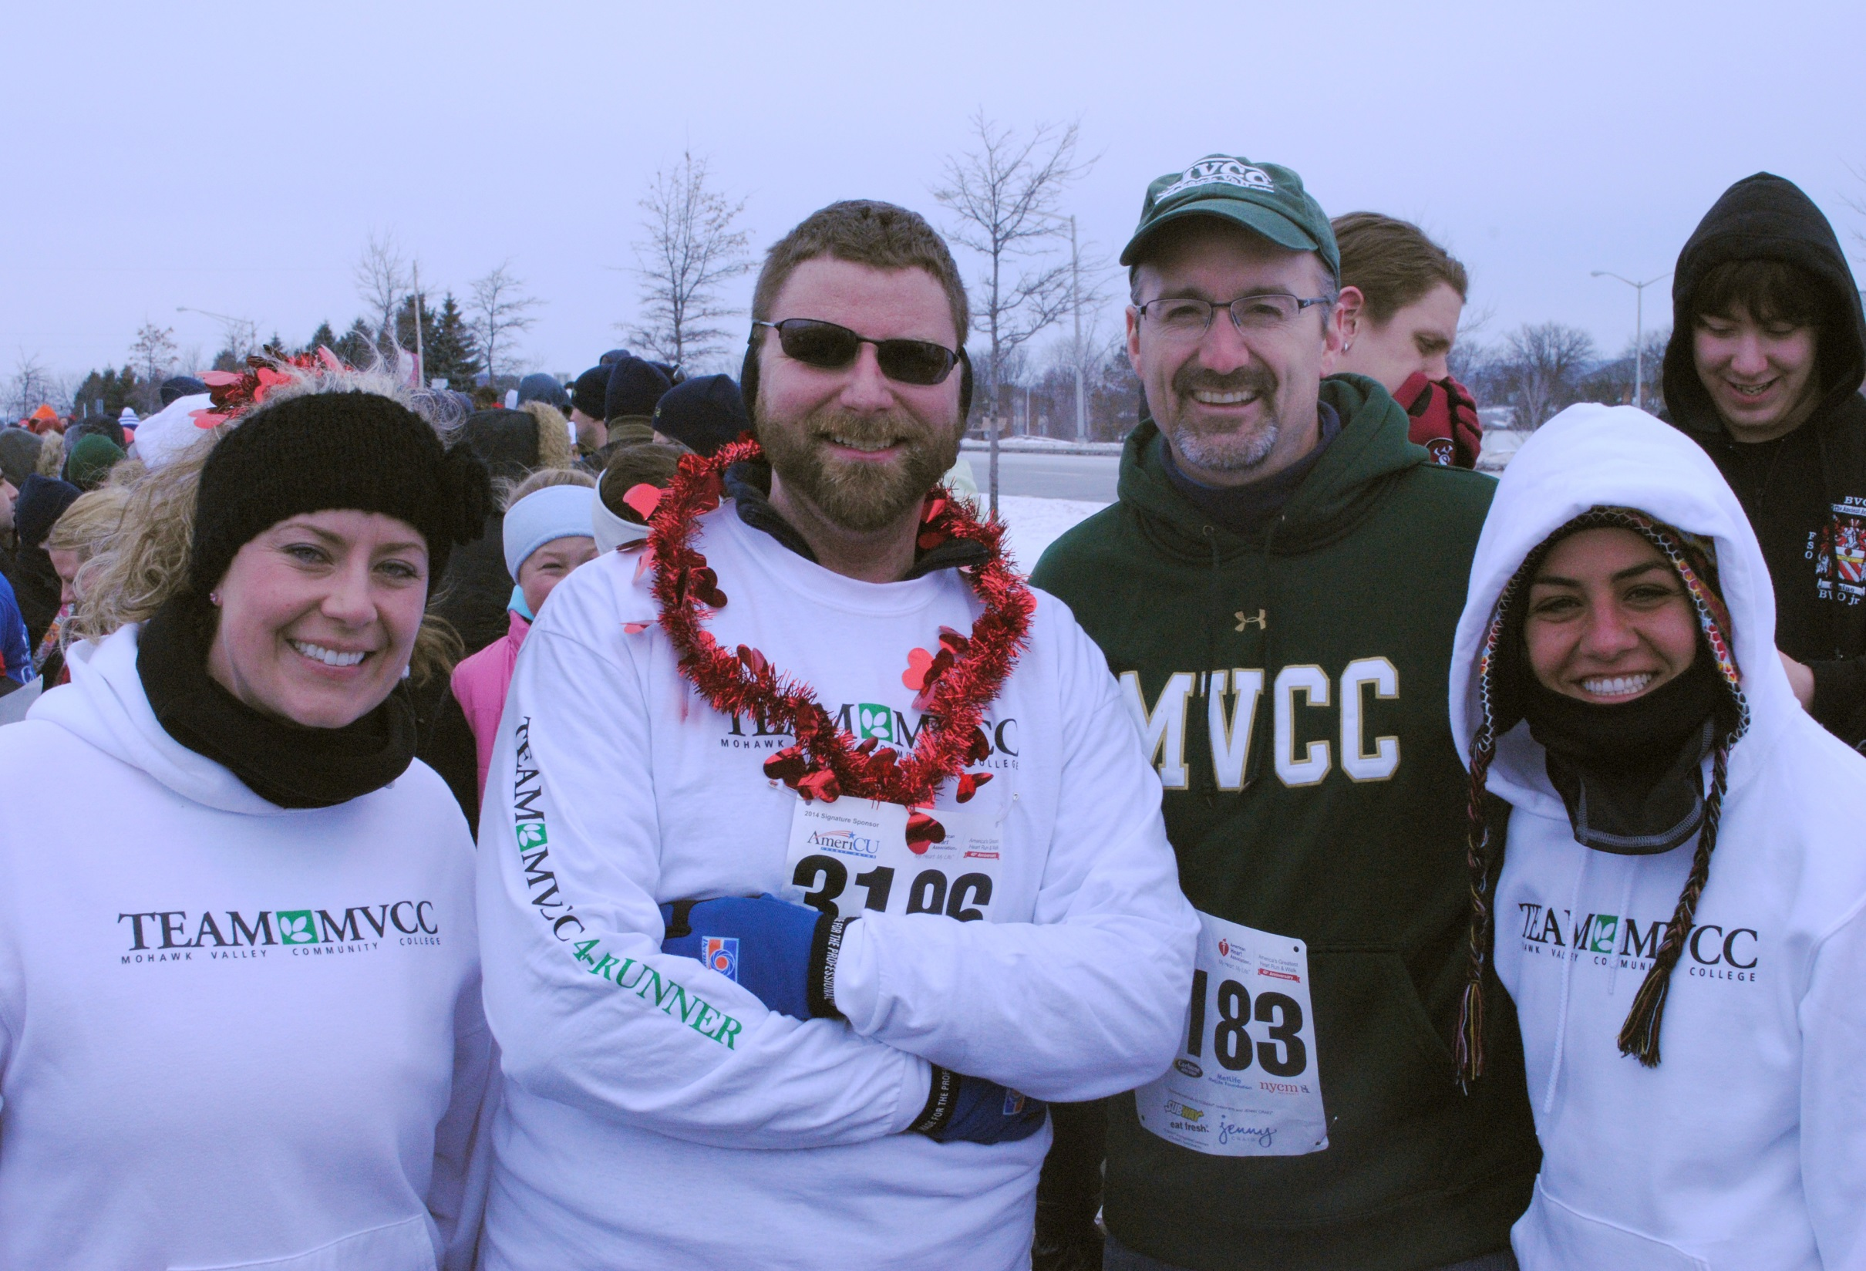
Physical
A lifetime of good habits promotes wellbeing

Slide 14
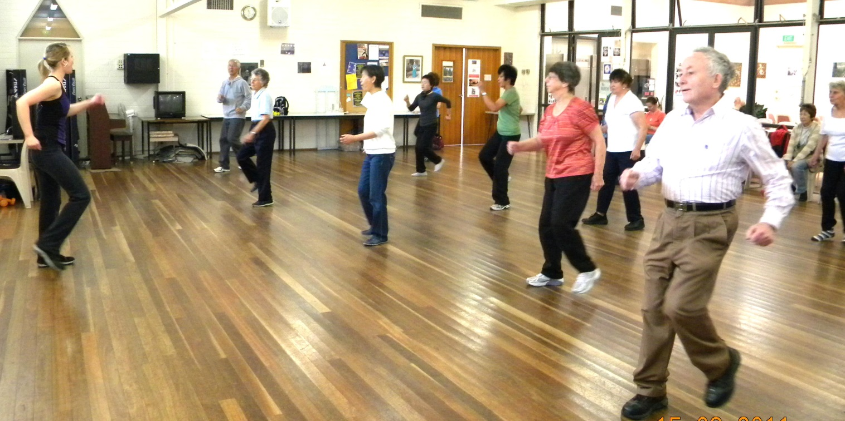
Physical
Do good things for yourself: exercise, meditate, sleep, rest

Slide 15
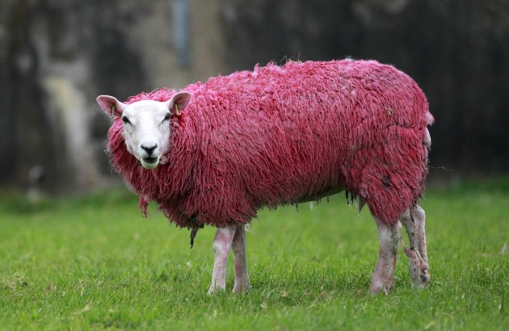
Physical
We can impact the expression of our genes

Slide 16
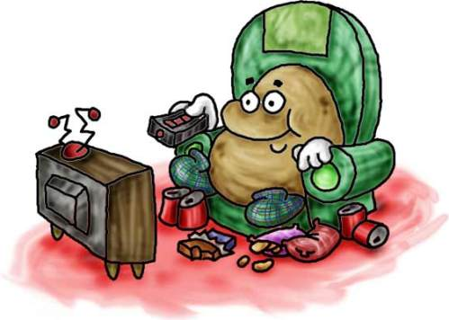
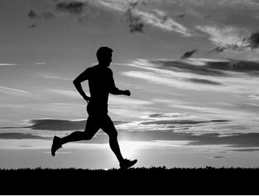
Physical
Make healthy food & exercise choices

Slide 17
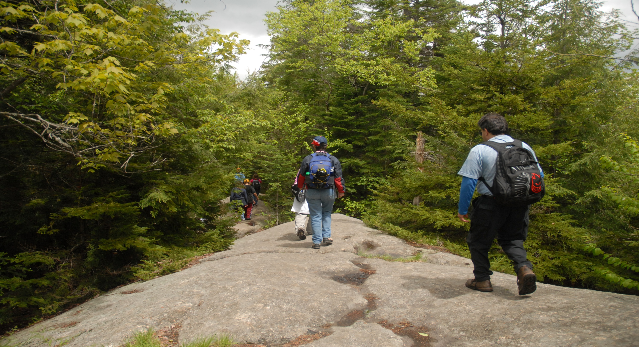
Financial
Beyond our essential needs,
more money does not equal more happiness

Slide 18
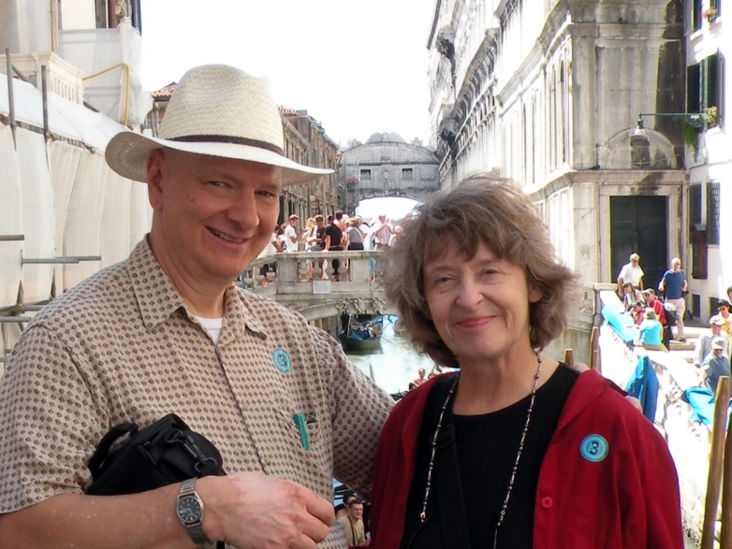
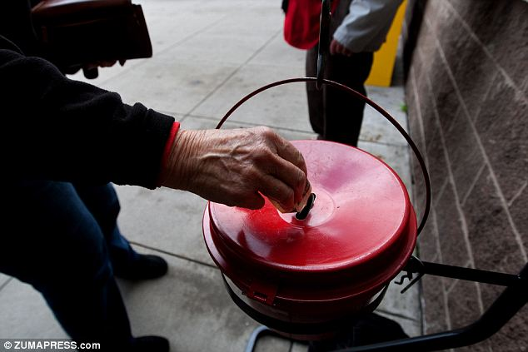
Financial
Spend money on experiences and on others

Slide 19
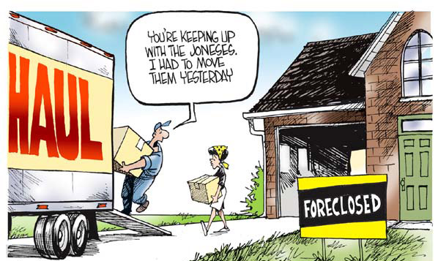
Financial
Debt and comparisons with others decrease wellbeing

Slide 20
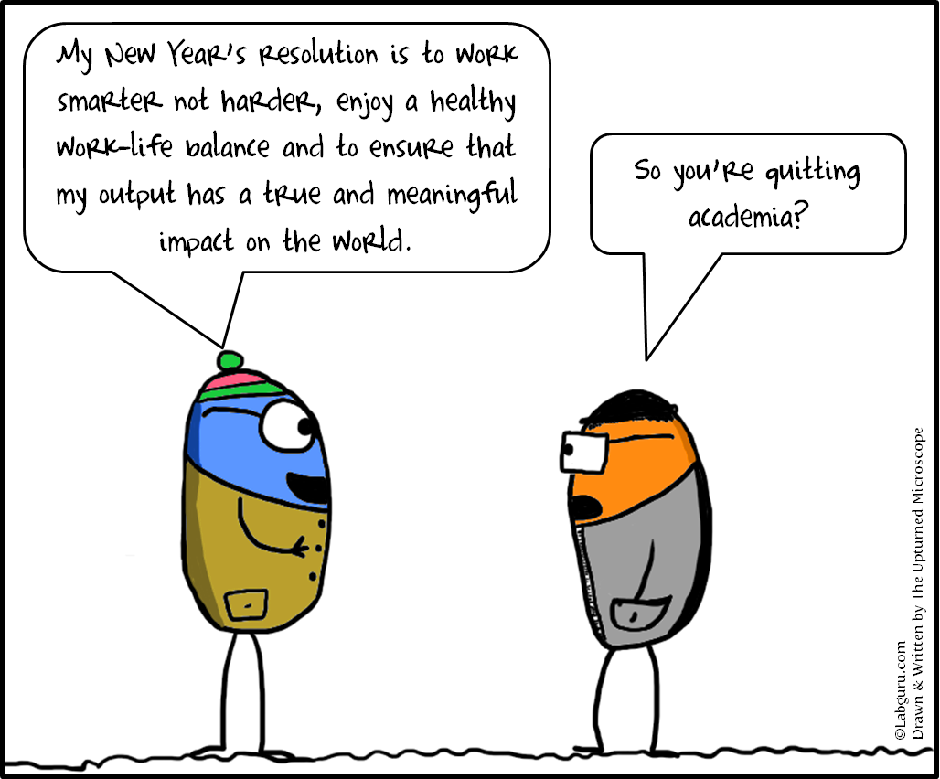
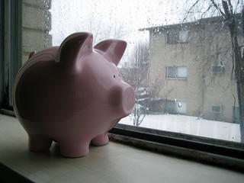
Financial
Set financial goals to save and live within your means

Slide 21
Community
Creating community: the difference between a good life and a great one!

Slide 22
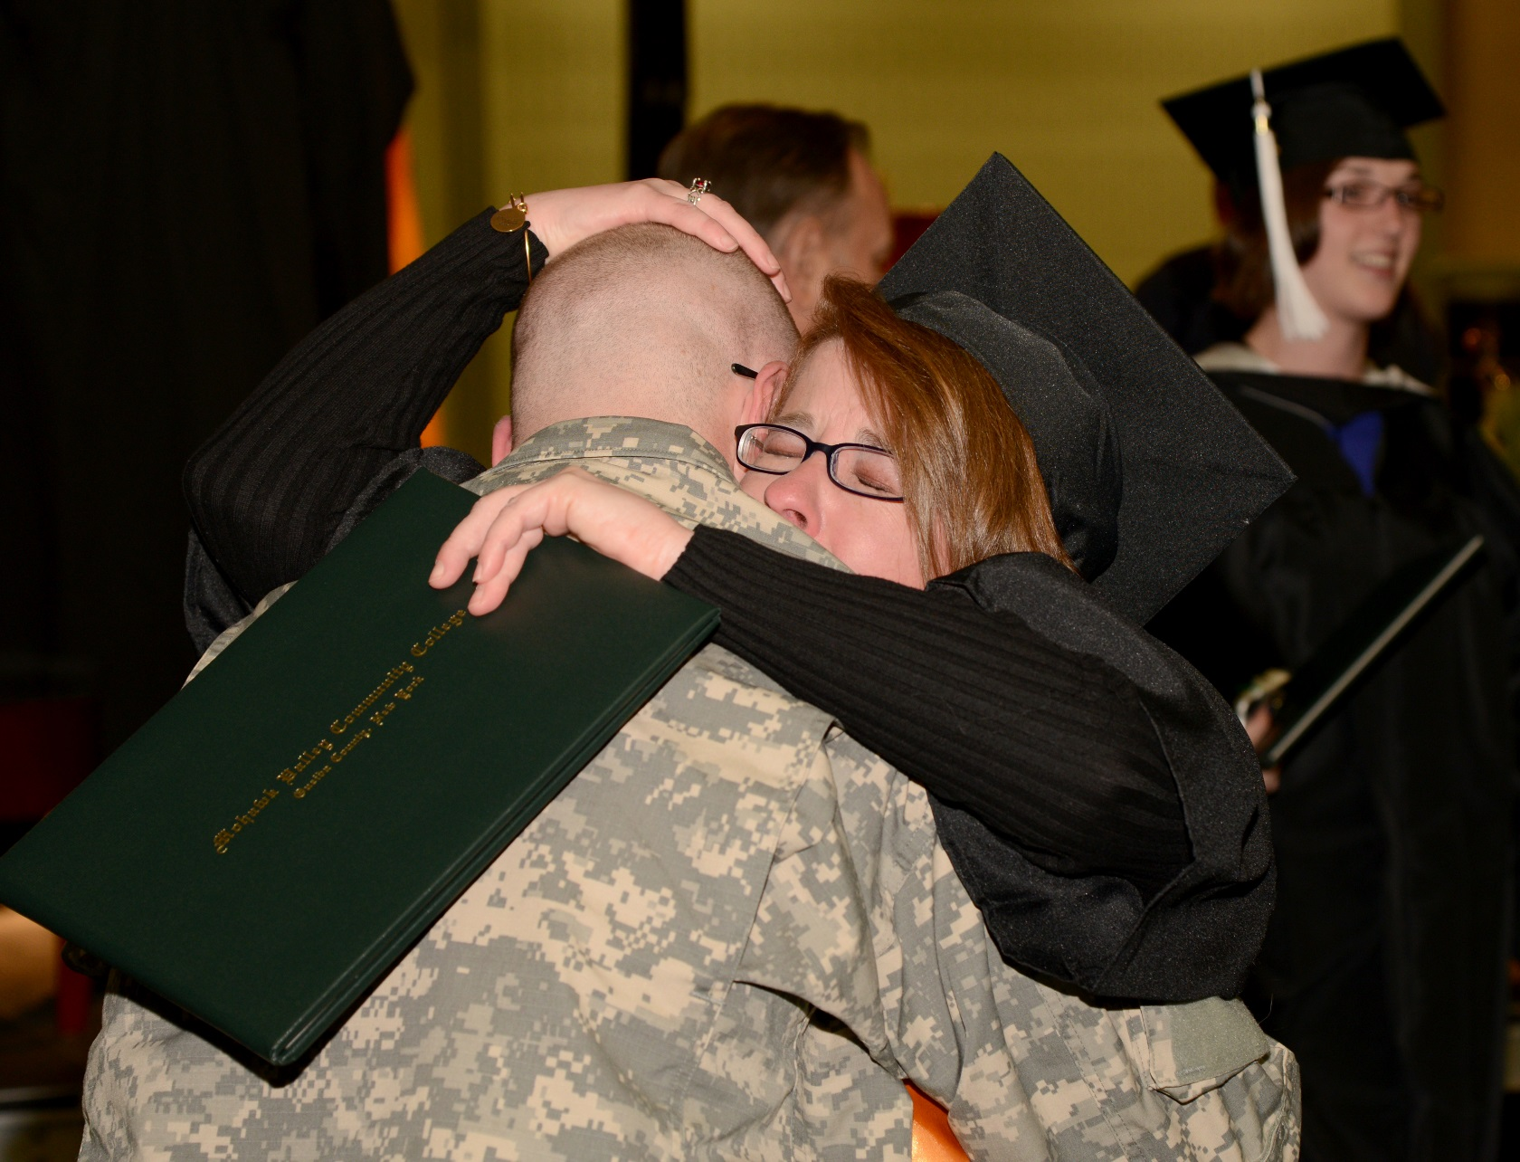
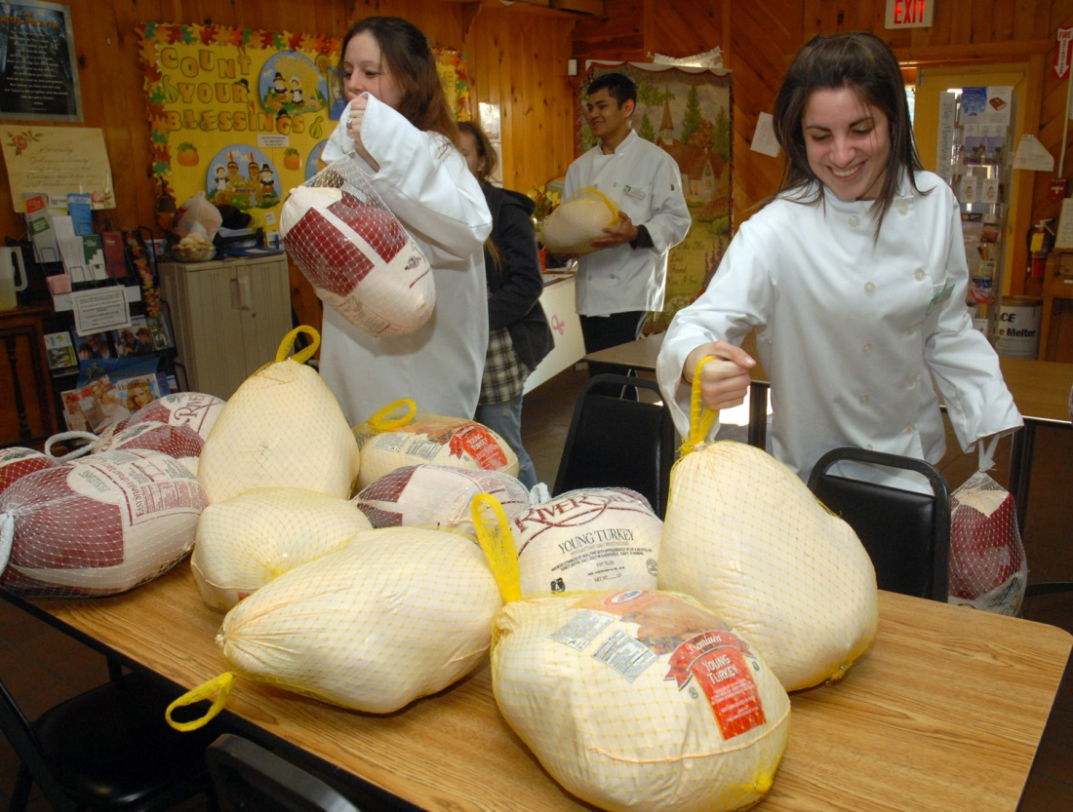
Community
Connect to the whole for greater good

Slide 23
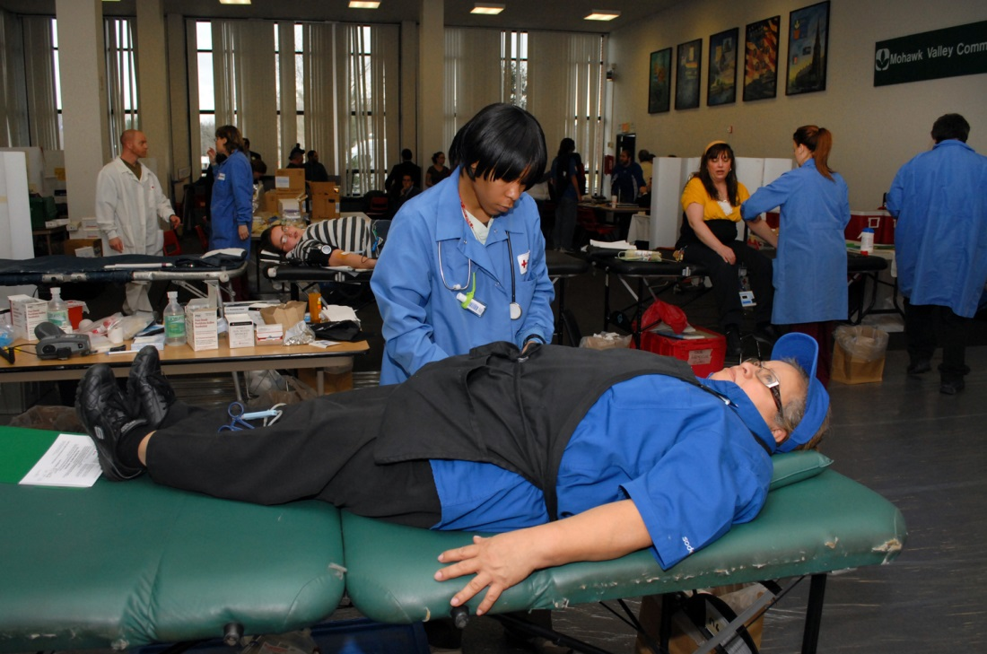
Community
Giving to others is giving to yourself

Slide 24
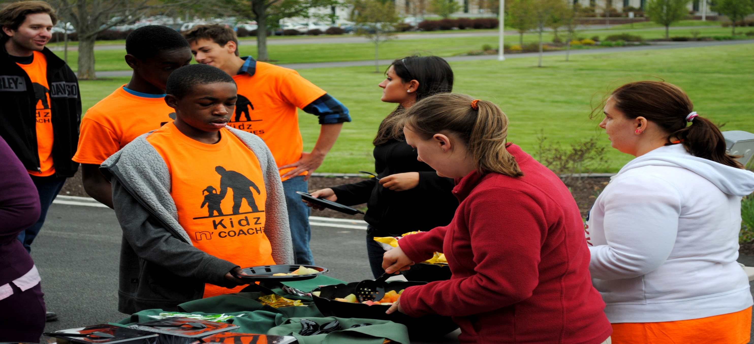
Community
Having a sense of community supports your wellbeing habits

Slide 25
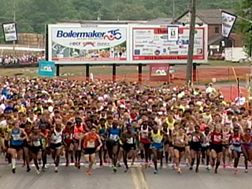
“How can the college through its processes, procedures, trainings or systems support and improve our physical, financial or community wellbeing?”
“How can the college through its processes, procedures, trainings or systems support and improve our physical, financial or community wellbeing?”
Activity
Notes:
Formal welcome, introduce yourselves. Explain the workshop’s purpose & objective of this workshop

Slide 26
Summary Activity
Are there any possible changes I can and want to make to improve my well being?
How can I improve the likelihood of achieving these changes?
Notes:
Formal welcome, introduce yourselves. Explain the workshop’s purpose & objective of this workshop

Slide 27
Thank you for attending!
Notes:
Formal welcome, introduce yourselves. Explain the workshop’s purpose & objective of this workshop

Slide 28
Thank you for attending
Core Workshop 2015
Notes:
Insert music loop for workshop
Welcome guests

