Slide 1
Mohawk Valley Community College
Core Workshop Campus Safety 2014
1

Slide 2
Mohawk Valley Community College
MVCC Mission Statement
Mohawk Valley Community College promotes student success and community involvement through a commitment to excellence and a spirit of service
2

Slide 3
Mohawk Valley Community College
Introductions
Core Workshop Introductions
3

Slide 4
Mohawk Valley Community College
Roles and Responsibilities
4

Slide 5
Mohawk Valley Community College
Roles and Responsibilities
What surprised you the most and why?
5

Slide 6
Mohawk Valley Community College
Public Safety Learning Objectives
Students will recognize Public Safety is trustworthy and accessible when needed.
.
6

Slide 7
Mohawk Valley Community College
Public Safety Learning Objectives
Students will recognize that Public Safety strives to maintain a safe and inclusive environment for all.
7

Slide 8
Mohawk Valley Community College
Public Safety Learning Objectives
Students will recognize that Public Safety officers follow a law enforcement code of ethics.
8

Slide 9
Mohawk Valley Community College
Strengths –Weaknesses - Opportunities -Threats
Students will recognize Public Safety is trustworthy and accessible when needed.
Students will recognize that Public Safety strives to maintain a safe and inclusive environment for all.
Students will recognize that Public Safety officers follow a law enforcement code of ethics.
9

Slide 10
Mohawk Valley Community College
Community Policing
“Police are the public and the public are the police.”
10
Notes:
List book reference for quote!

Slide 11
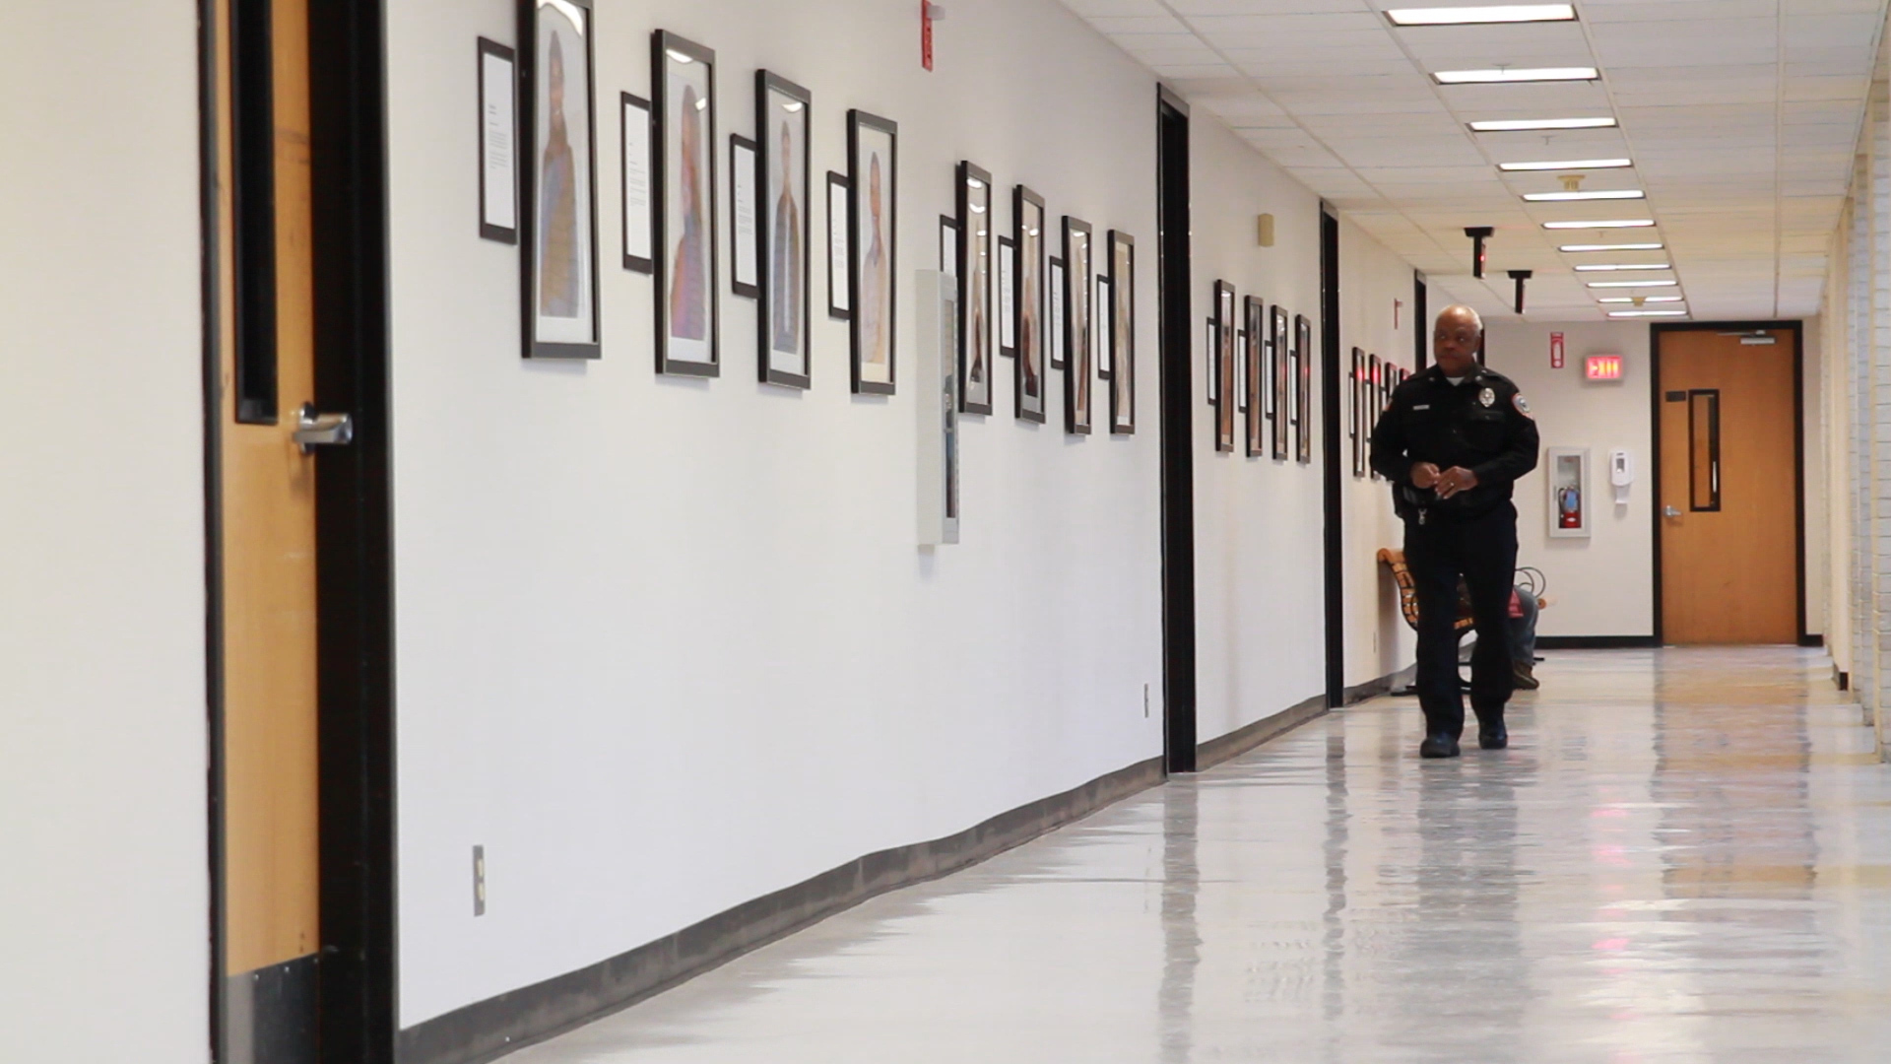
Mohawk Valley Community College
Community Policing
****Foot patrol: Creates visibility, more one on one interaction with community and officer.
11

Slide 12
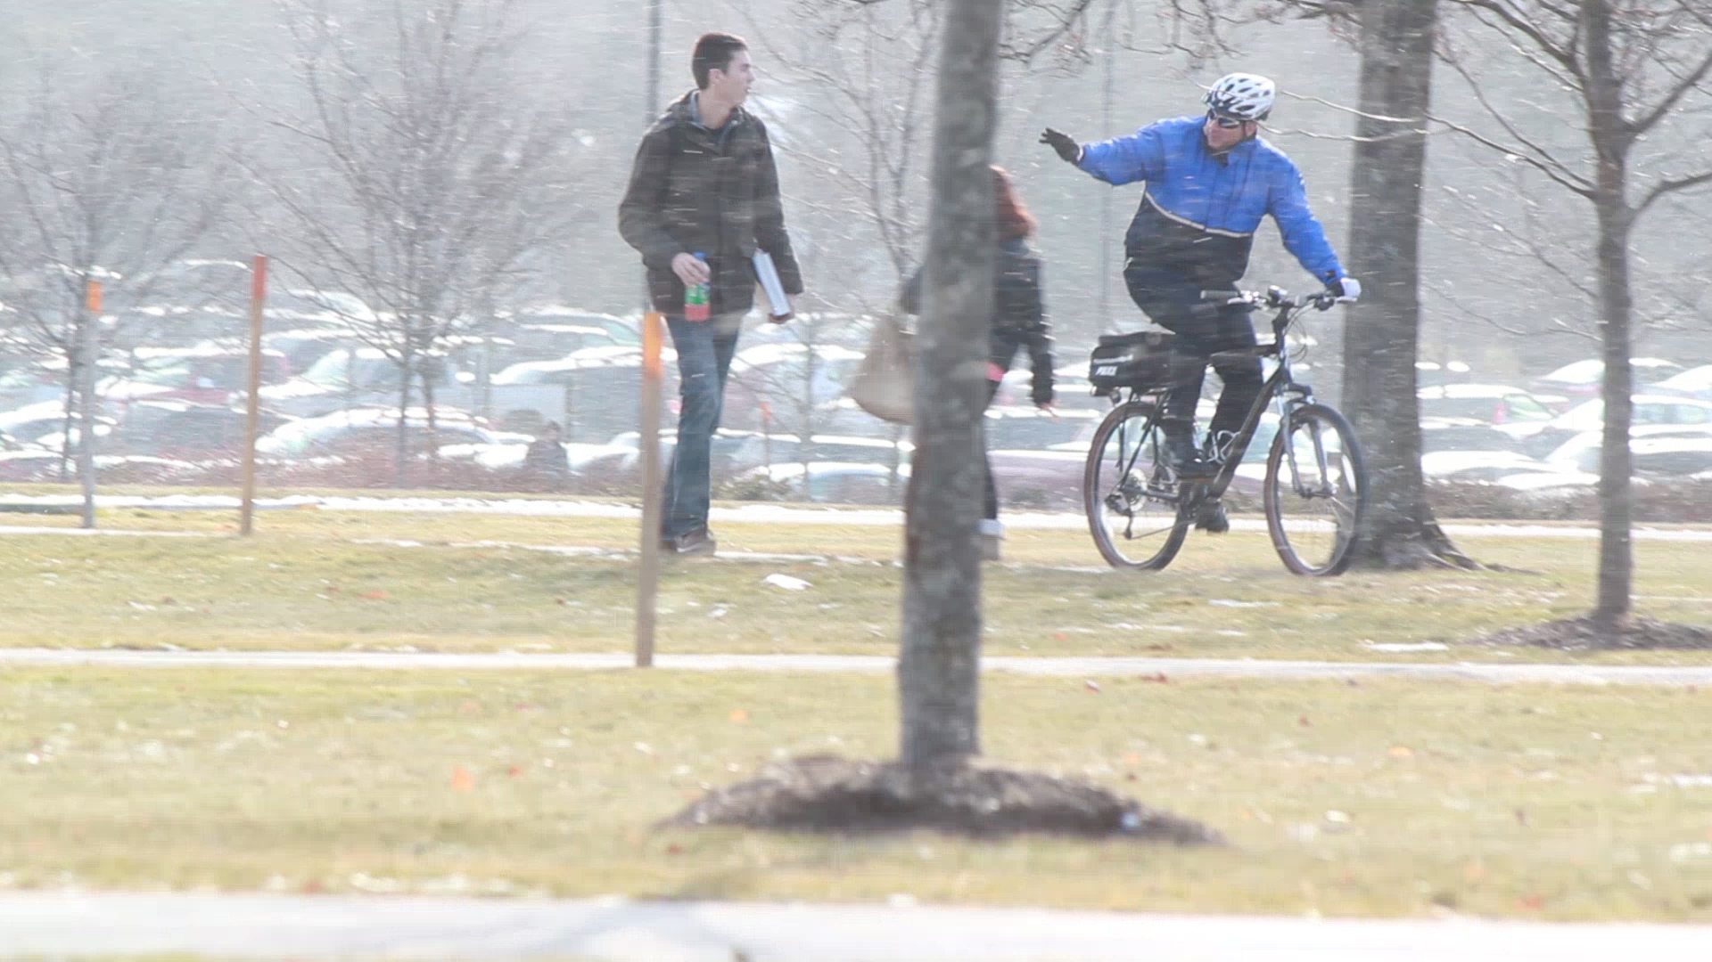
Mohawk Valley Community College
Community Policing
****Bike Patrol: Creates visibility, allows for more patrol area coverage.
12

Slide 13
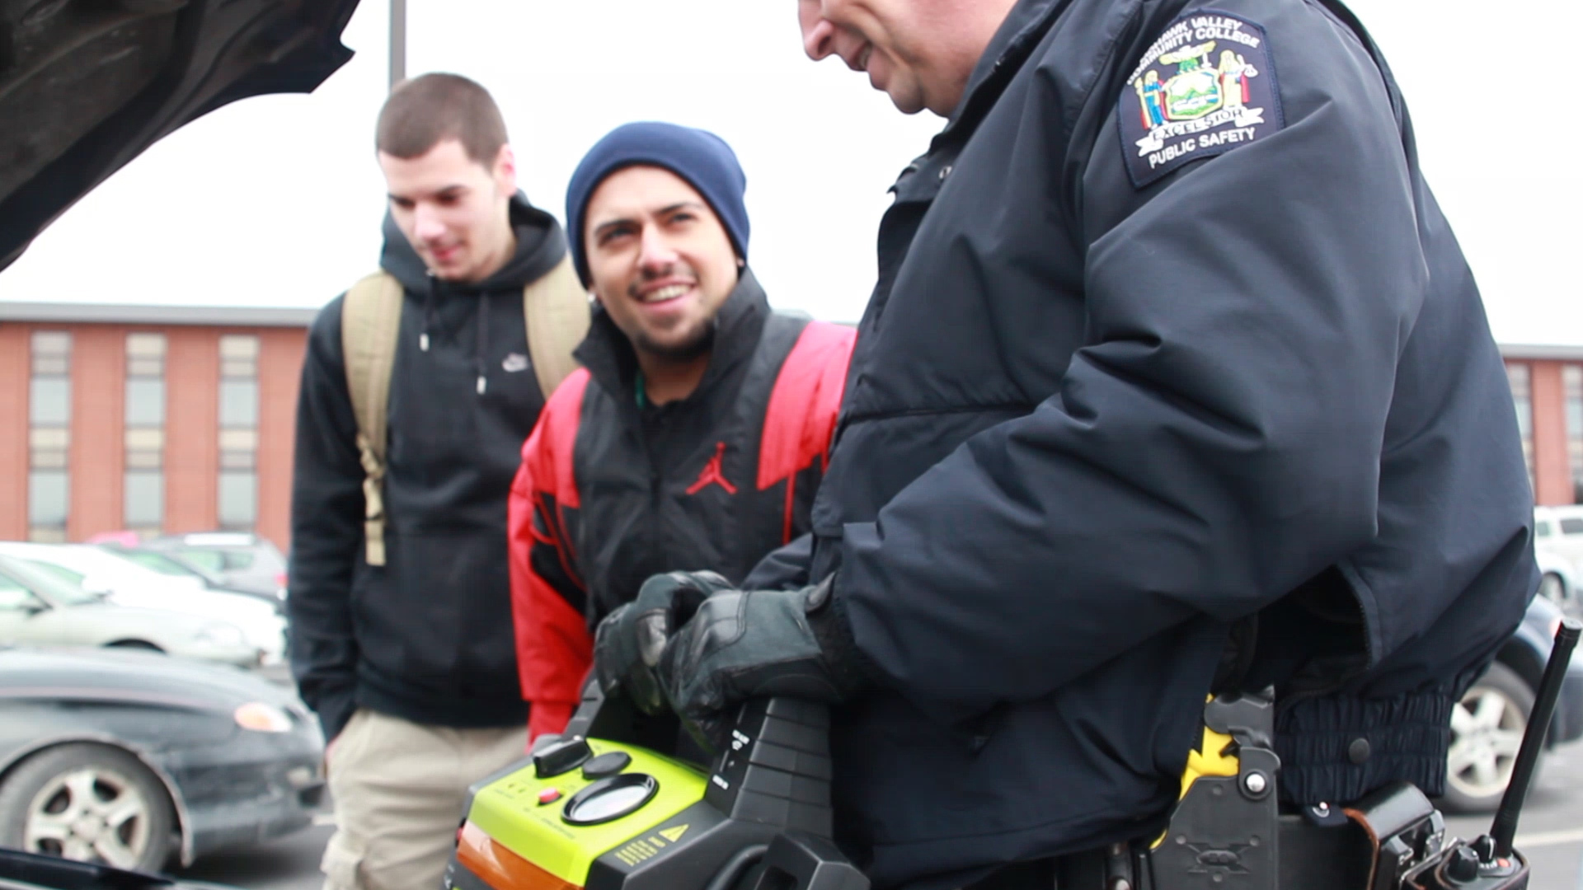
Mohawk Valley Community College
Community Policing
****Calls for service (i.e. jump starts, lock outs): One on one interaction with community members.
13

Slide 14
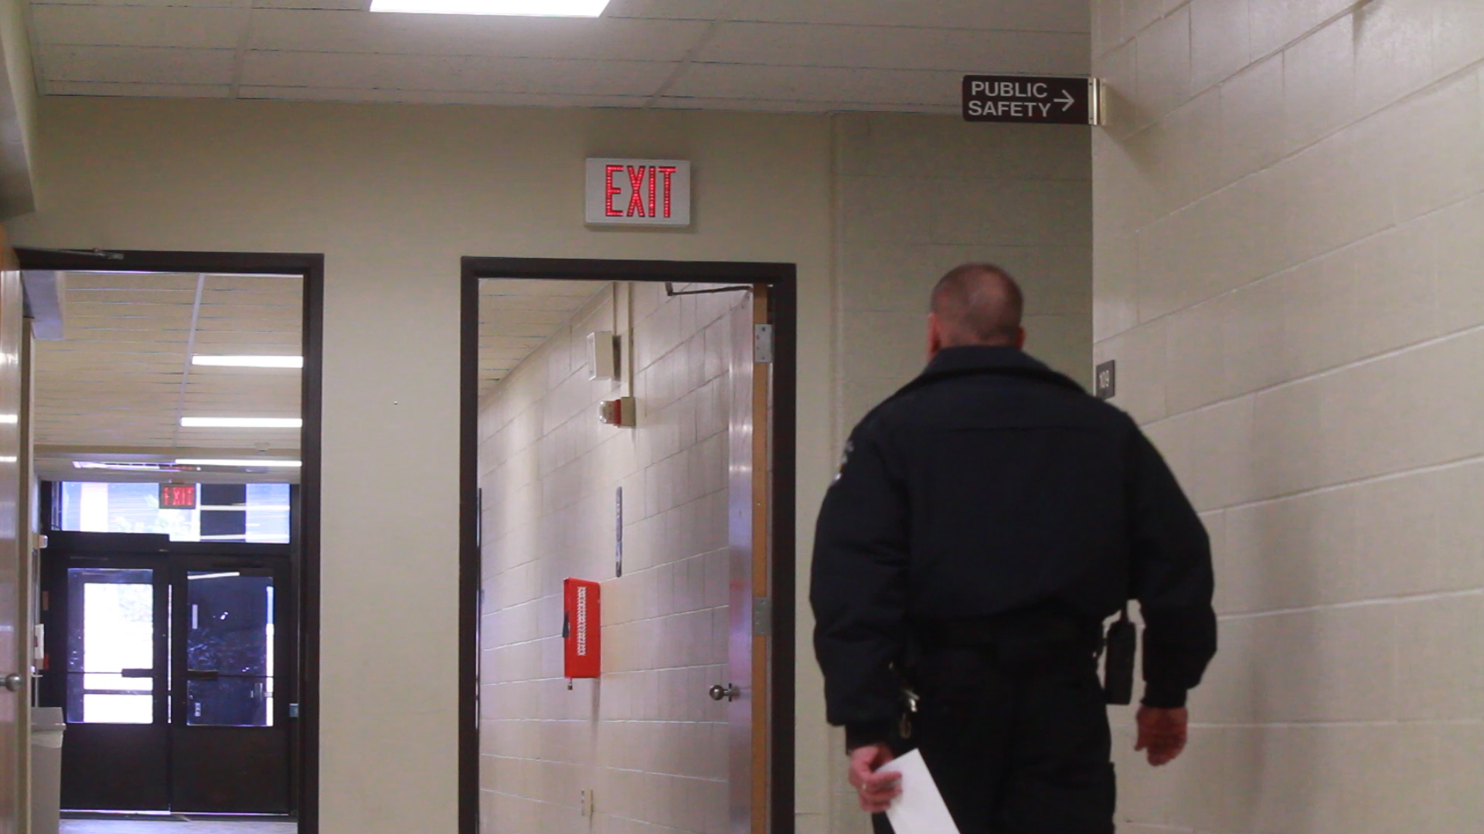
Mohawk Valley Community College
Community Policing
****Building checks: Helps local businesses stay safe and feel safe.
14

Slide 15
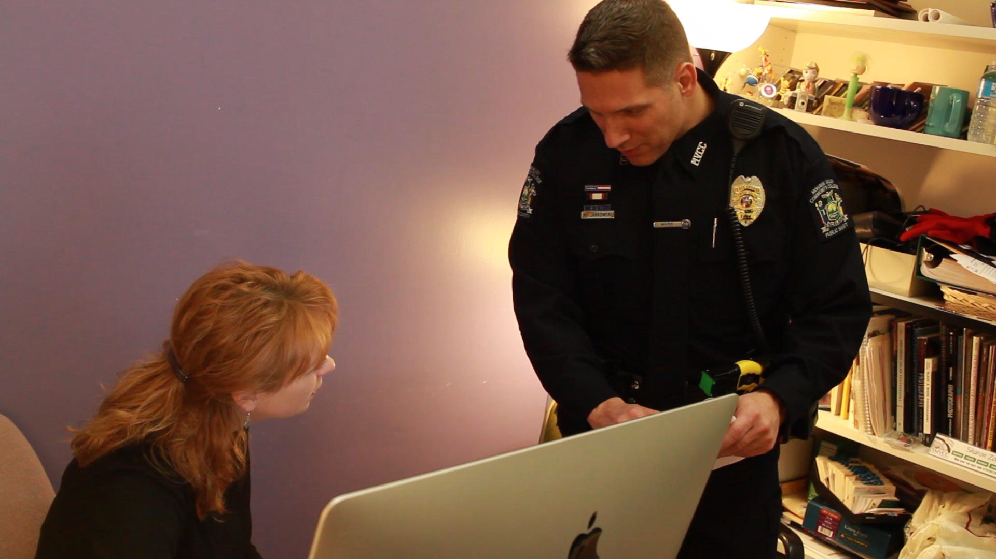
Mohawk Valley Community College
Community Policing
****
*****Speaking engagements: Officers speak to local organizations such as Lions Club or Rotary.
15

Slide 16
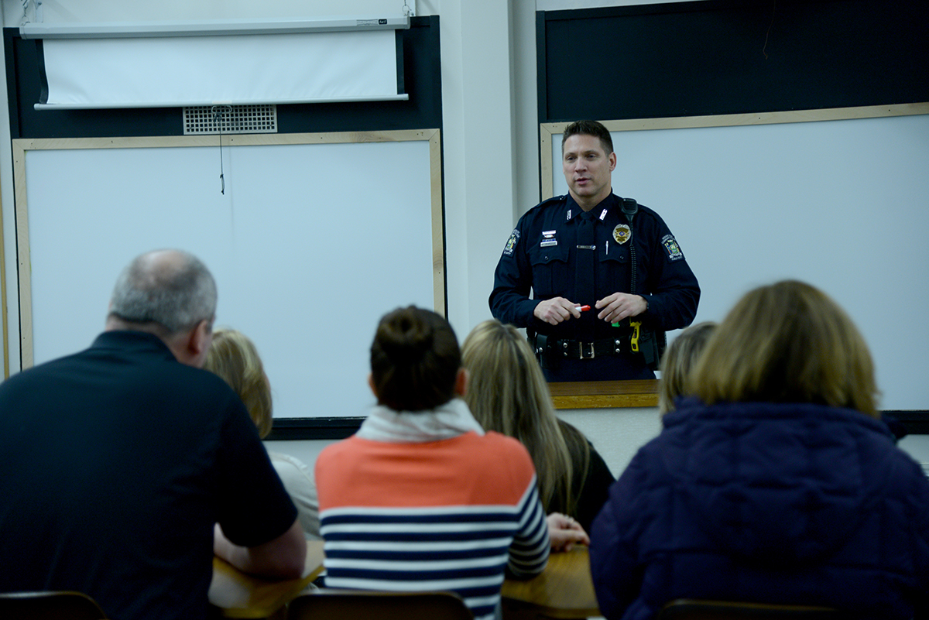
Mohawk Valley Community College
Community Policing
****
*****Speaking engagements: Officers speak to local organizations such as Lions Club or Rotary.
16

Slide 17
Mohawk Valley Community College
Community Policing
Connected communities improve the quality of life.
17

Slide 18
Mohawk Valley Community College
Emergency/Crisis Response
Initiatives – post Virginia Tech
Communications
External alarm system on Utica Campus
Telephone alarm system
Implementation of NY-alert system
Weekly activation testing of NY-alert system
Annual activation testing of external alarm system
Web-based alert messaging system
18

Slide 19
Mohawk Valley Community College
Emergency/Crisis Response
Initiatives – post Virginia Tech
Infrastructure
Repair/refurbish of blue light phones
Hiring and training of peace officers (nearly 50%) with proper equipment and tasers
Coordination meetings regarding emergency response
Security camera expansion/upgrade on both campuses
19

Slide 20
Mohawk Valley Community College
Emergency/Crisis Response
Initiatives – post Virginia Tech
Enhancements
Crisis response team certified in FEMA sponsored National Incident Management System (NIMS)
Annual simultaneous activation testing of NY-alert, external alarm, phone, and web messaging system
Aligned public safety radios w/mutual aid
Safety committee recommendation to add blue phone and lighting in the A-3 parking lot in Utica
20

Slide 21
Mohawk Valley Community College
Emergency/Crisis Response
Initiatives – post Virginia Tech
Training
Expanded crisis response team with additional NIMS certifications
Conducted first of bi-annual table top exercises with more than 20 expanded crisis response team members
Training all Public Safety staff on simplicity reporting system
Replication of CRT and NIMS at Rome Campus
CRT Chair participation in Homeland Security Workshop
21

Slide 22
Mohawk Valley Community College
What If?
“Evacuate vs. Shelter in place”
Communication system
First Call
(Utica-731-5777; Rome-334-3559)
Need for volunteers
22

Slide 23
Mohawk Valley Community College
Jeopardy
23

Slide 24
Mohawk Valley Community College
We need your feedback
Next Steps
24

Slide 25
Mohawk Valley Community College

Slide 26
Mohawk Valley Community College
Thank you for attending !
26

