Slide 1
MVCC Web CMS Refresher Workshop
August Institute 2022

Slide 2
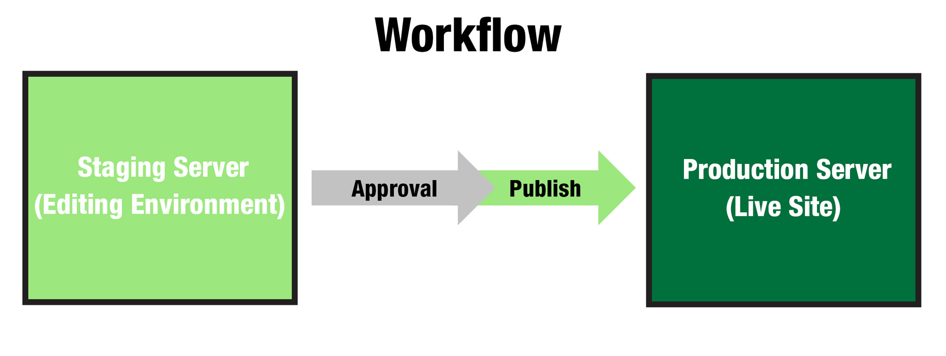
CMS Overviews
Modern Campus CMS is a Decoupled Content Management System

Slide 3
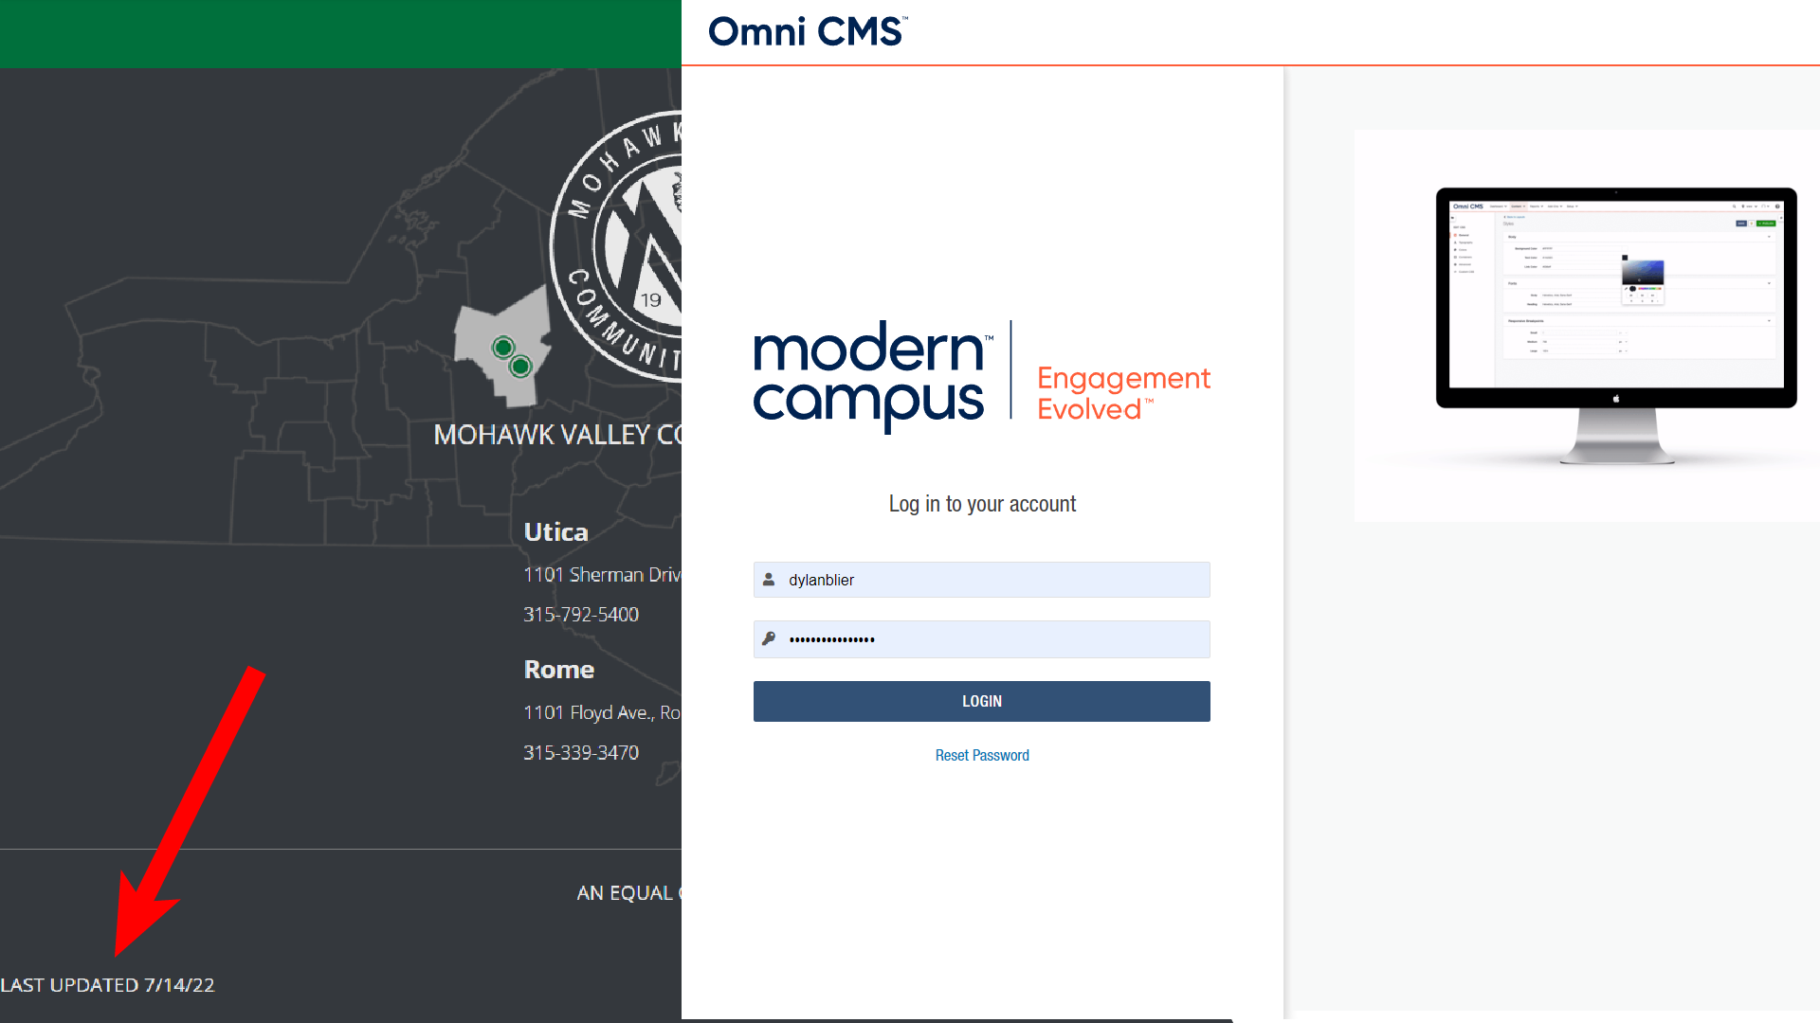
Log-In
Enter your password (MVCC Alias and network password)

Slide 4
File Directory

Slide 5
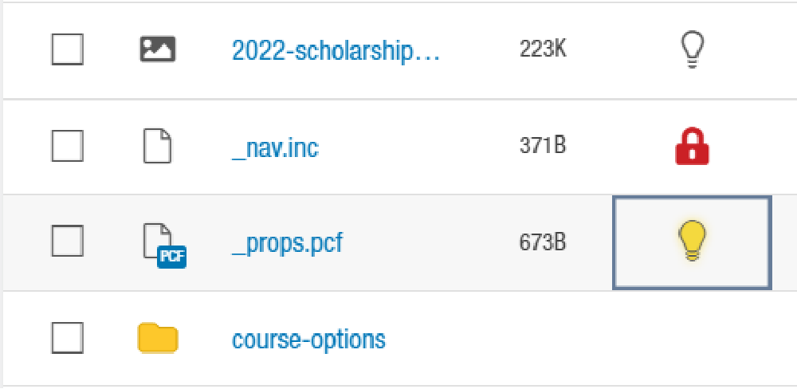
Check-in/out
best practice, check in to the page (Turn off the light) whenever you finish editing.

Slide 6
File Types

Slide 7
Editing a page

Slide 8
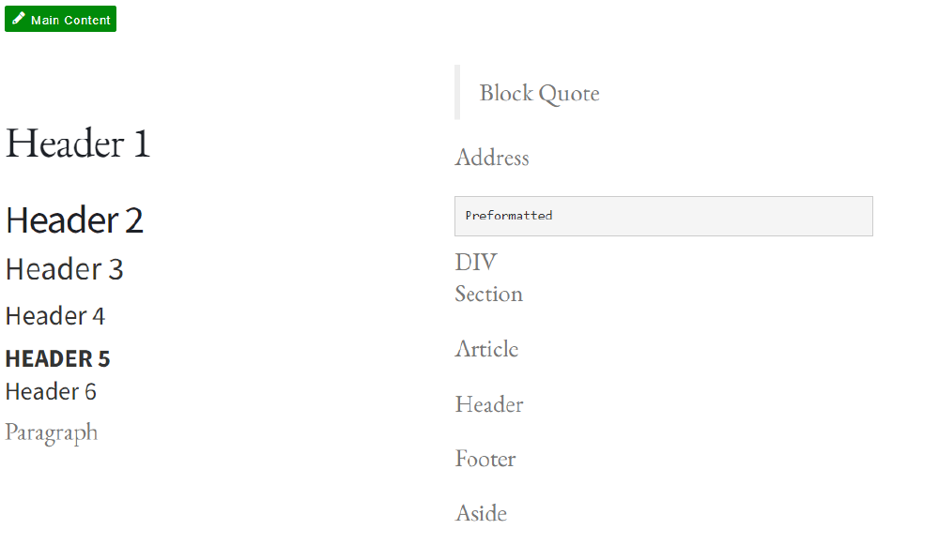
Formatting Text
Headings goes from 1 -5. Heading 1 being the highest heading and is already defined at the page level. You can only have a single Heading 1 on each page. To edit Heading 1, Make the change under Properties.
Headings 2 should allow after Heading 1. Headings 2s are the highest heading in the main content region. You can have multiple Heading 2 based on your content structure.
Multiple Headings 3 can be establish following each Heading 2 based on your content structure.
Multiple Headings 4 can be establish following each Heading 3 based on your content structure.
Best practice: Break down your content into pieces for easy reading experience, if possible.

Slide 9
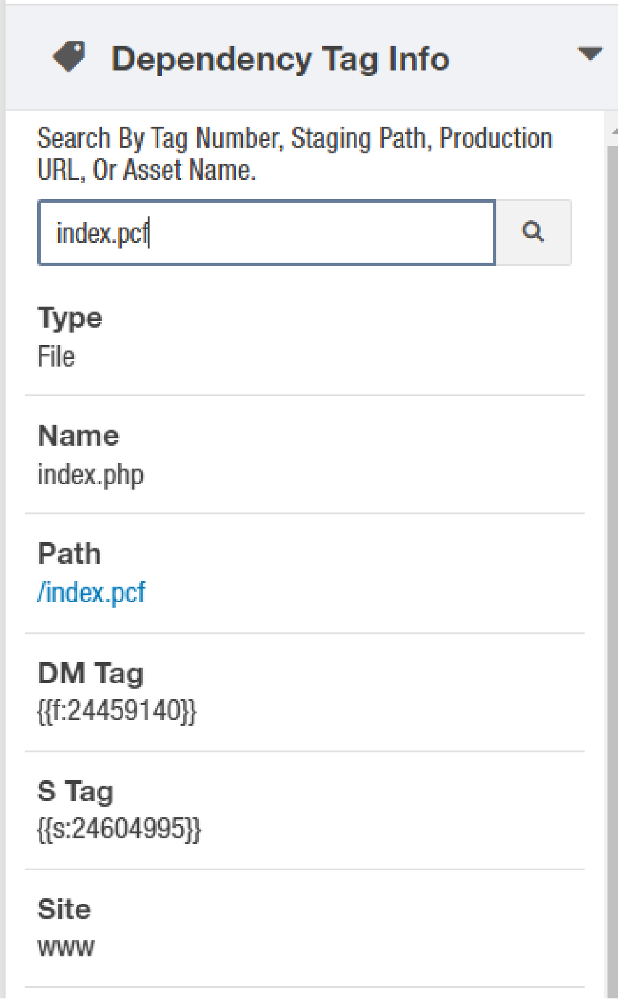
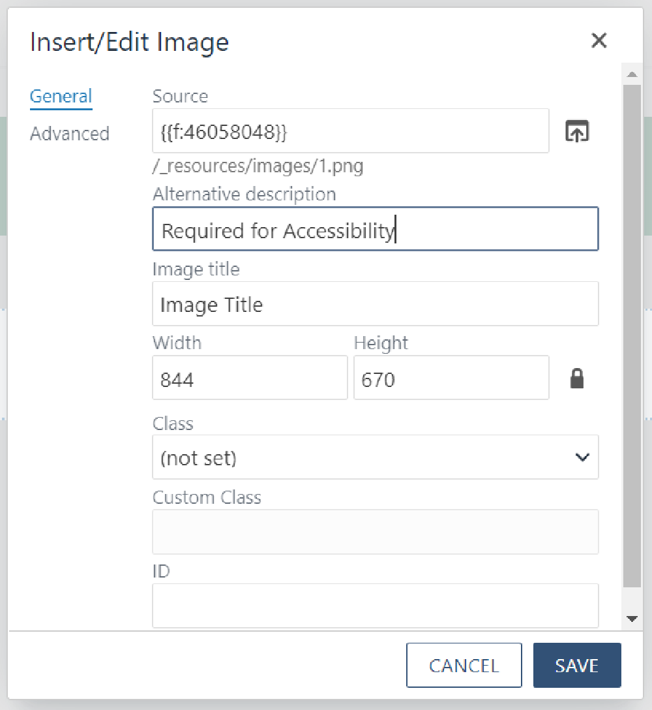
Dependency Tags
Dependency Tag is used to express linkage to an element within the CMS. a page or other web assets With dependency tag, files can be easily relocated without breaking links from other pages that use the file.

Slide 10
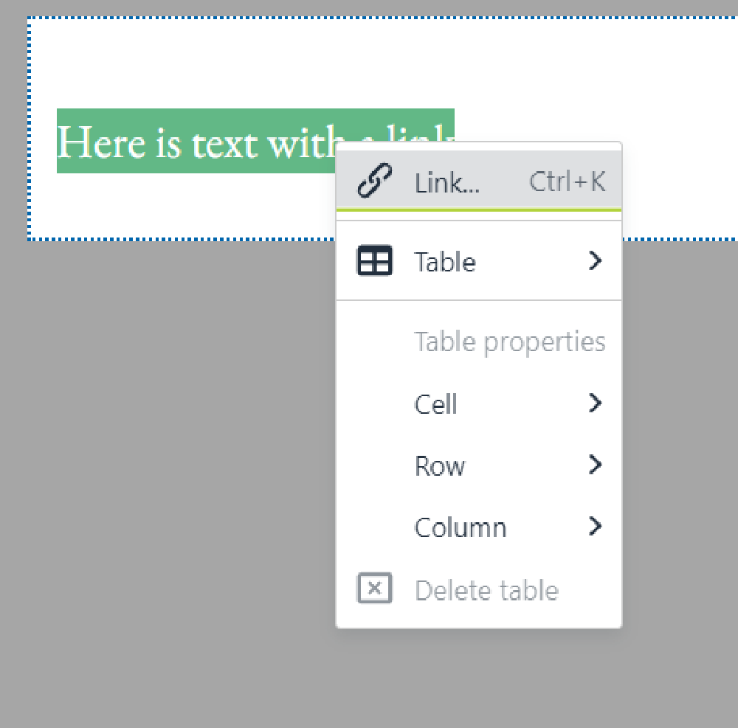
Creating Hyperlink
To create Hyperlink, Use Rich Text Editor in the content region. Select your text, right click, then designate the link using dependency manager.
For email link, enter: mailto: abc@mvcc.edu
For telephone link, enter: tel: 315-315-1234

Slide 11
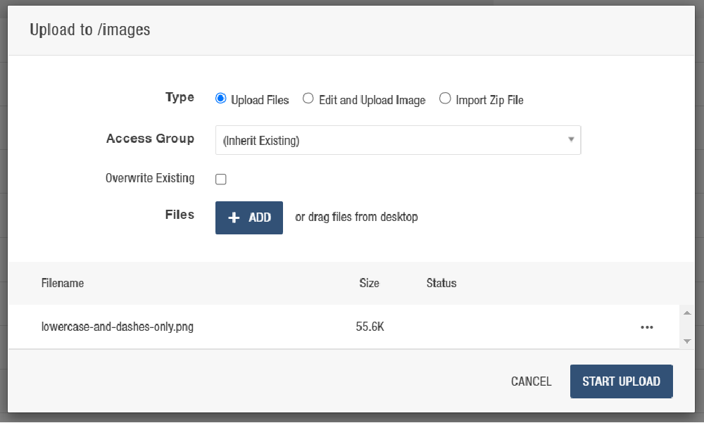
Embedding an Image
The image file size should be as small as possible.

Slide 12
Uploading Files
navigate to your designated directory, then click Upload at top. Drag the file to the Upload prompt.

Slide 13
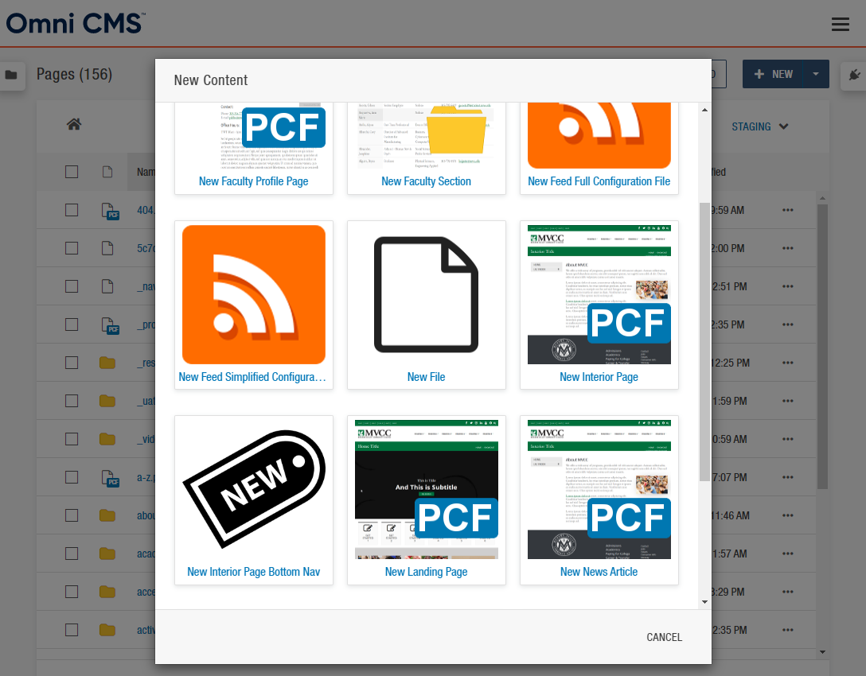
Templates
Templates provides a predefined layout for a page. There are currently 2 types of templates: Landing Page and Interior Page.

Slide 14
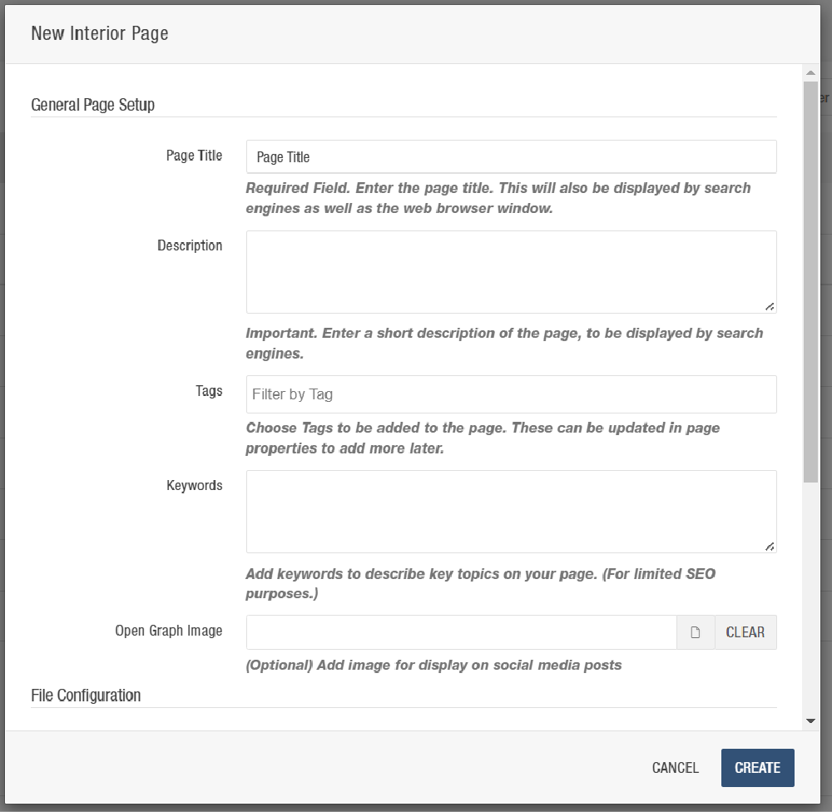
Creating a page
When naming the files, there should not be a space. Just dashes instead of any space. Description is text that shows up underneath the page in the Search Engine.
Files are accessed by many users, so make sure the naming conventions are simple, recognizable and intuitive. If you accidentally created a page without a file, the file name will be generated as “Untitled.pcf”

Slide 15
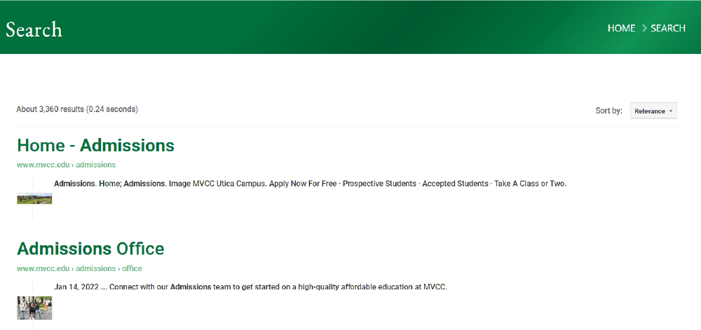
Search Results
To get a better search ranking, the keyword is relevancy. The best way to improve search is by finetuning content.

Slide 16
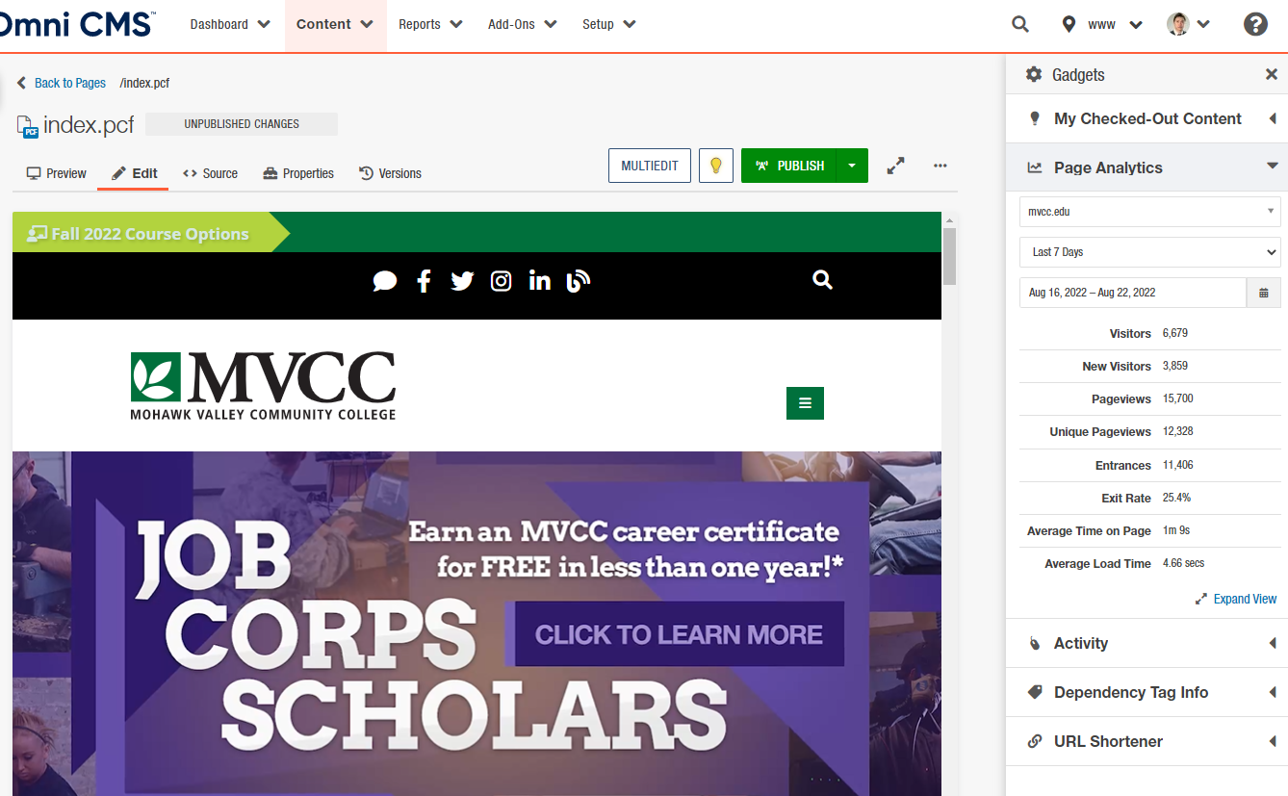
Page Stats
Page Gadgets (Side Bar on Right) > Page Analytics

Slide 17
Content Strategy
Consider what kind of content you have:
Frequency of update?
Are you able to edit graphics?
Do you have recurring content such as upcoming events?
Form vs pdf
Consistency/Branding
Accessibility
Image Contrast / Readability
Hyperlinks: Avoid “Click Here”
Custom Web Page: If you see a layout idea that you like and potentially work for your purpose, it is good to start a document, and prepare to adapt with your own content

Slide 18
Future Expansions
More Text Formatting
More Snippets
Custom Webpages
Personalization (Dynamic Content)

Slide 19
Useful Tools
Simple Image Editor: Photo (Windows), Gimp (Windows Store)
Icons: https://fontawesome.com

Slide 20
Questions?
Thank you for joining this workshop!

