Slide 1

Communication, Connection, and Collaboration: Learning to Liaise with Academic Affairs
With Marianne Buttenschon, Lew Kahler,
Dawson McDermott, and Justin Rahn

Slide 2
Who we are
Marianne Buttenschon, Dean,
Center for Social Science, Business and Info. Tech.
Lew Kahler, Dean,
Center for Arts and Humanities
Dawson McDermott, Coordinator of Academic Advisement
Justin Rahn, College Advisor

Slide 3
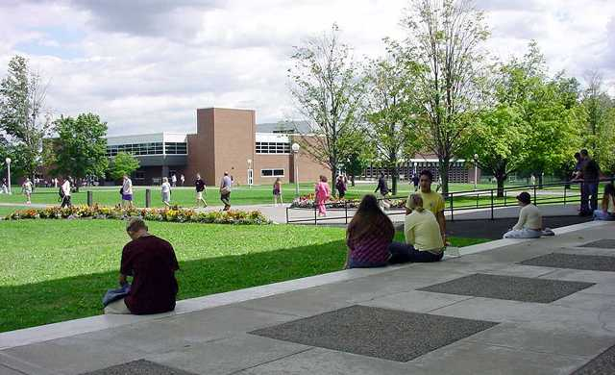
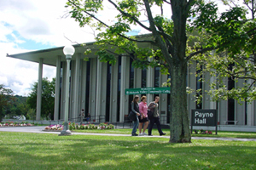
Where we Work
Mohawk Valley Community College
  Main campus in Utica, NY
  Secondary campus in Rome, NY
90+ majors
Enrollment – 7,451 total students (Fall 2012)
69% receive Pell Grant

Slide 4
Goals and Purpose
Context of where have been and where we are now
Sense of why we started the liaison system
Current Center liaison practices
Benefits and challenges
Future directions

Slide 5
Understanding where we have been

Slide 6
Previous Academic Affairs Structure
12 Academic Departments
Art
Business and Info. Tech.
Engineering, Comp. and Physical Sciences
Engineering, Technology, and Trades
Health Services
Hospitality
Humanities
Life Sciences
Mathematics
Psychology, Human Services, and Education
Physical Education
Social Sciences and Criminal Justice

Slide 7
Previous Advisement Structure
Staff
  Director
  Assistant Director
Reported to Academic Affairs Division
Faculty-based

Slide 8
Understanding where we are now

Slide 9
Current Academic Affairs Structure
5 Academic Centers
Social Sciences, Business and Information Sciences (BISS)
Arts and Humanities (CAAH)
Language and Learning Design (CLLD)
Life and Health Sciences (LAHS)
Science, Technology, Engineering, and Mathematics (STEM)

Slide 10
Current advisement structure
Reports to Student Affairs Division
Current staff
  Associate Dean for Student Enrollment and Retention Services
  Coordinator of the First Year Experience
  Coordinator of Academic Advisement
  2 College Advisors, 1 Advisement Specialist
  11 part-timer advisors
Faculty still have advising loads

Slide 11
Reasons for the liaison System
Student congress meeting
  Desire for more faculty connections
  Concerns over the quality and consistency of academic advising
Need for better communication with Centers
  Program, course, prerequisite changes
  Advisement procedures and protocols
Putting theory into practice

Slide 12
Initial In-Roads and Broader adoption
Center for Arts and Humanities
  Dawson’s initial efforts
Natural pairing of Centers with most liaisons
  Justin’s work with Nursing and Allied Health
  Carla’s former C-STEP role and STEM
  Liz’s education advising role and CLLD
  Tracy’s educational background and BISS
Building upon existing relationships and communication streams

Slide 13
Center Liaison Practices

Slide 14
Social Sciences, Business & Info. Sci.
Semesterly meetings with Dean and Asst. Dean
Help with specialized programmatic advising, such as Fire Protection, Cybersecurity, and Law Enforcement
Follow-ups with re-matriculated students
Help with DegreeWorks questions

Slide 15
Arts and humanities
Credit evaluations
Graduation evaluations
Student outreach concerning degrees/courses
Monthly meetings with Dean and Asst. Dean
Center meetings with faculty
Handling difficult students
DegreeWorks training for faculty
Registration issues for faculty and students

Slide 16
Language and learning design
Monthly meetings with Dean and Asst. Dean
Manage learning community enrollment
Reschedule cancelled class students
Assist with some Center events, like Open House
Train Advisement Center staff in advising CLLD programs, i.e. Education majors
Outreach to students who have failed courses

Slide 17
Life and health sciences
Registered Nursing selection committee
Radiologic Technology selection committee
Registered Nursing student database manager
Selection rubric management and prerequisite conversations
“Pre-healthcare” student meetings and discussions

Slide 18
Science, Engineering, Tech., and Math
Attend Center meetings
Monthly meetings with Dean and Asst. Dean
Tracking student course demands and available seats
Organize small Center events, such as “Meet Your Dean” or registration parties
Email faculty reminders and updates

Slide 19
Reasons for unique practices
Center administration structures are different
  Dean and Assistant Dean for BISS, CAAH, CLLD, STEM
  Dean, Assistant Dean, two Associate Deans for LAHS
Centers have different needs for involvement

Slide 20
The Present and future

Slide 21
Benefits of the System
Builds bridges between Academic Affairs and Student Affairs
Deeper understanding of the Centers’ operations and reasoning
Creates relationships amongst staff, faculty, and administrators
Easier to expedite important communications

Slide 22
Challenges of the System
Timely communication of changes in procedures and protocols
Keeping up with the volume of new academic information and changes
Newness of the process and structure
Uncharted territory

Slide 23
Future Directions
More consistency in practices
Continue to strengthen communication pathways, i.e. meetings, emails, etc.
Enhance faculty and staff collaboration

Slide 24
Questions, Comments, thoughts

Slide 25
Contact Information
Lew Kahler
lkahler@mvcc.edu
315-792-5409
Marianne Buttenschon
mbuttenschon@mvcc.edu
315-792-5463
Dawson McDermott
dmcdermott@mvcc.edu
315-731-5819
Justin Rahn
jrahn@mvcc.edu
315-731-5810

Slide 26
Slides
Available at:
www.mvcc.edu/academic-advisement/nacada-2014

