Slide 1
Adopting Adaptive Learning
Every Learner Everywhere
Unless otherwise noted, this presentation by Achieving the Dream and Every Learner Everywhere is licensed CC BY 4.0.

Slide 2
Adaptive Learning – MyLab Mastering
MyLab Mastering is a pre-made supplemental courseware for online homework, tutorials, and assessments from Pearson publishing. It is already in use at BC and can been integrated into Blackboard environment.
MyLab Mastering has the most extensive list of premade courseware.

Slide 3
Adaptive Learning – Realizeit
Create 1:1 individualized learning paths powered by the Realizeit Adaptive Intelligent Engine. This self-learning engine continuously adapts to each learner’s changing ability and manages its own accuracy and performance.
The platform continuously measures each learner’s knowledge and ability so that it can map, shape, and drive a personalized learning experience allowing teachers and trainers to adjust and tailor their approach as necessary, and to measurably achieve the learning goals.

Slide 4
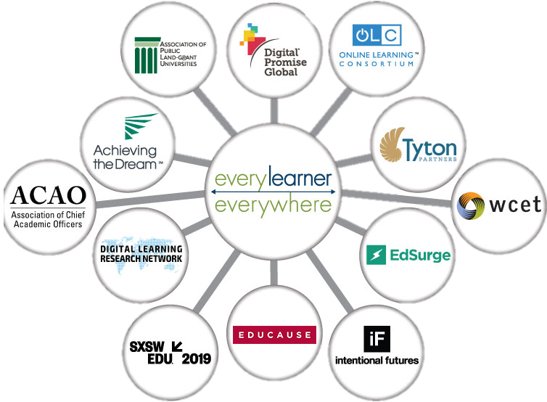
Every Learner Everywhere
Every Learner Everywhere (ELE) network brings together 12 partner organizations to help colleges and universities navigate the rapidly evolving digital learning landscape.
The mission of ELE is to help institutions use new technology to innovate teaching and learning, empower instructors, and improve student outcomes—especially for first-generation college students, low-income students, and students of color.

Slide 5
What is adaptive courseware?
How does it work?
Students answers to initial questions and assessments generate additional questions and activities to further their mastery of material.
Students can track their own learning and engage in their progress through customized learning dashboards
Definition
Adaptive learning systems are online educational systems that modify the presentation of content in response to student performance.
Adaptive systems capture fine-grained data and use feedback loops to create personalized learning pathways.

Slide 6
The Lighthouse Institutions

Slide 7
Preliminary Findings
STUDENTS
Learning
Confidence
Engagement
FACULTY
Faculty Collaboration
Evidence-Based Teaching Practices
COVID-19 Rapid Response
Both students and faculty reported fewer transition issues when moving fully online
Notes:
We are already seeing the benefits of this work from our pilot and early implementation phase.
Our Preliminary Findings
90% of the instructors in the pilot said they believed the AC increased student learning
Adaptive courseware Increased student confidence and engagement in learning
Increased opportunities for faculty collaboration in course development
Faculty who used adaptive courseware were more likely to report using evidence-based teaching practices
During the rapid transition Both students and faculty reported Less of transition issues when the courses went fully online
I will now pass the mic to Achieving The Dream’s dynamic president Dr. Karen Stout who will share more about our work

Slide 8
Adaptive Courseware

Slide 9
The Backward Design Process

Slide 10
Step 1: Identify Desired Results

Slide 12
Step 2: Determine Acceptable Evidence

Slide 13
Step 3: Design Learning Experiences

Slide 15
Examples of course structures with adaptive courseware

Slide 16
Leveraging Learning Analytics to Inform Teaching

Slide 17
Onboarding Students

