Slide 1
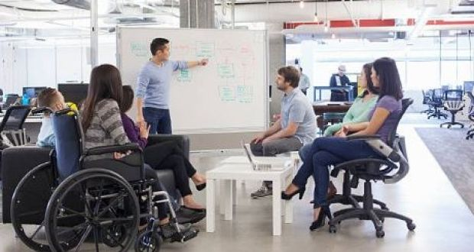
Accessibility Requirements of Learning
Prepared by Tamara Mariotti
2019 |Office of Accessibility Resources –PH 104H

Slide 2
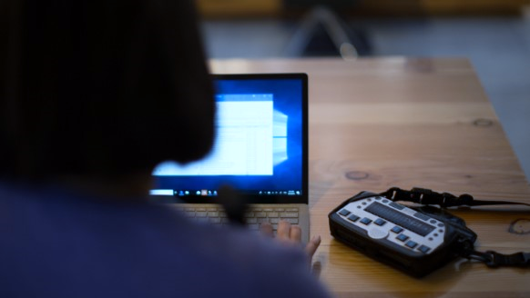
TODAY'S AGENDA Let's Talk about Accessible Design for all
2019 |Office of Accessibility Resources – PH 104H
Introduction
Major Laws Regarding Accessibility
How to "Make It Accessible“
Communicate Accessibility Needs for a Project
Evaluate if a Learning Project is Accessible
Contacts

Slide 3
Introduction
Accessibility is a right. Everyone—including those with disabilities and those without—can benefit from accessible teaching materials.
Every decision that we make as designers can include or exclude different learners. It is our responsibility to lower these barriers and offer inclusive experiences.
Many educators are uncertain how to create accessible course materials. There are so many ideas about being user-friendly. This workshop will bring you to the core of not only the legal aspects of accessible design but assist with understanding modern social construct of today's educational pedagogy.
2019 |Office of Accessibility Resources –PH 104H

Slide 4
Key Accessibility Laws & Guidelines EQUAL ACCESS TO AND PARTICIPATION IN PROGRAMS, SERVICES, & DIGITAL CONTENT
Accessibility Laws
Universal Guidelines
Section 504 of the U.S. Rehabilitation Act of 1973, as amended
Americans with Disabilities Act of 1990 (ADA), as amended
Section 508 of the U.S. Rehabilitation Act of 1973, as amended suggests following WCAG 2.0 minimum Guidelines AA standards.
Web Content Accessibility Guidelines (WCAG) 2.0
The World Wide Web Consortium (W3C) is an international community that develops open standards. The Web Accessibility Initiative (WAI) standard is
Universal Design for Learning
Universal design for learning (UDL) is a framework to improve and optimize teaching and learning for all people based on scientific insights into how humans learn.
2019 |Office of Accessibility Resources – PH 104H

Slide 5
HOW TO “MAKE IT ACCESSIBLE “ Click on the video:
https://www.youtube.com/watch?v=3f31oufqFSM

Slide 6
Design Distinctions & Overlaps
Accessibility
Accessibility addresses discriminatory aspects related to equivalent user experience for people with disabilities.
Usability
Usability and user experience design is about designing products to be effective, efficient, and satisfying.
Inclusion
Inclusive design, universal design, and design for all involves designing products, such as websites, to be usable by everyone to the greatest extent possible, without the need for adaptation.
https://www.w3.org/WAI/intro/usable
2019 |Office of Accessibility Resources – PH 104H

Slide 7
Top Ten Tips for Web Accessibility
Choose a content management system that supports accessibility
Use headings correctly to organize the structure of your content
Include proper alt text for images
Give your links unique and descriptive names
Use color with care
Design your forms for accessibility
Use tables for tabular data, not for layout
Ensure that all content can be accessed with the keyboard alone in a logical way
Use ARIA roles and landmarks (but only when necessary)
Make dynamic content accessible & create an accessibility statement so someone can reach you if there are concerns or problems
2019 |Office of Accessibility Resources –PH 104H

Slide 8
What specific Tools do we have at MVCC?
SENSUS Access
Read & Write Gold
Video Captioning
CART (Communication Access Real-time Translation) services
Video Description
Braille Request
Audio books/E-Text
Converting PowerPoint
Etcetera

Slide 9
What is Sensus Access?
Self-service, conversion tool
Converts PDF’s, JPEGS, PowerPoints, and other files into text files, MP3s, digital braille, EPUB, and more…

Slide 10
Where is Sensus Access?

Slide 11
“Make it Accessible” webpage

Slide 12
Demonstration: How to use it…

Slide 13
Demo- picture format (.JPG)

Slide 14
Sent back in 3 minutes to mvcc.edu email

Slide 15
Promote SensusAccess!!
Share it with students for preferred learning style needs
Offer alternate formats in Blackboard courses and the college website

Slide 16
Checklist for Accessibility Curriculum Design
Evaluate if a Learning Project is Accessible
!
1. Have you anticipated different learning styles, preferences, abilities, and needs?
2. Have you allowed students an element of choice in how they learn?
3. Is the structure of teaching sessions communicated to students in advance or at the start of each session?
4. Are a variety of assessment options available?
5. Are course materials accessible, and designed to support different learning styles?
6. Are session materials made available in advance?
7. Is key module information disseminated to students in a timely manner?
8. Are expectations clearly communicated to students?
9. Are students able to present their own feedback at different stages of the module? (Involve People With Disabilities (PWD) whenever possible)

Slide 17
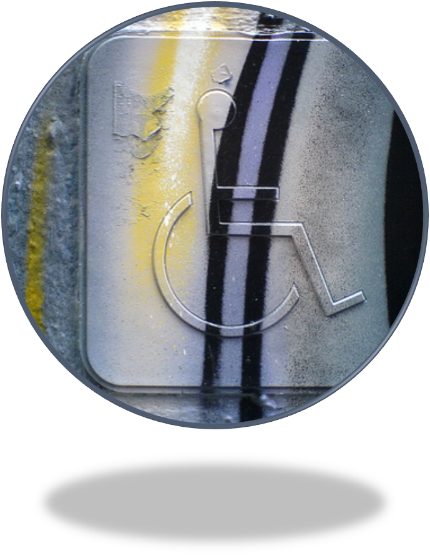
CONTACT the Office of Accessibility Resource Tamara Mariotti, Coordinator of Accessibility Resources (PH104H) tmariotti@mvcc.edu 315-731-5702
Utica Campus –
Payne Hall 104F
Main phone 315-792-5644
Web Address
https://www.mvcc.edu/accessibility-resources
Email address
oar@mvcc.edu

