Slide 1
Captioning
&Video Compliance
January Institute 2018

Slide 2
Objectives:
Promote learning about captioning & review MVCC Video Procedure of 2012
Reach 100% compliance for providing closed-caption for all videos used in online and hybrid classes or in Blackboard Supplemental course sites.
Provide tools on how to request captioning for videos through an updated process for captioning through a centralized video Library
Understanding why we caption videos

Slide 3

The audio portion of a video presentation is inaccessible to those with hearing loss and deaf
SWD 490-500 students Fall 2017
3% of the students registered with the disability office is Deaf or Hard of Hearing
1% of students registered with the disability office is blind or visually impaired
Captioning promotes and provides equal access to communication and learning for students

Slide 4
Captioning history for MVCC
Innovative Grant 2015 -Closed Caption & Signed Video-Podcasts’ for online classes (Stacey McCall & OAR)
YouTube channel – Worked with work study students to caption videos for specific departments
Realized any video over 3 minutes is not worth doing in-house. Started sending them out for processing.
Future years: expand this project to include all online-faculty in the second and third year until MVCC online courses are 100% compliant

Slide 5
Three styles of Captioning
Open Captions -always are in view and cannot be turned off
Closed Captions -can be turned on and off by the viewer
Descriptive Videos -the accessible use of narration for the blind and visually impaired
Sample Description Video

Slide 6
MVCC Video Procedure of 2012
When purchasing new video, check to see if a captioned version is available
When your syllabus, DGV or other college programs includes the use of DVDs, or online and digital media, it is necessary to determine if they are closed captioned
It is not acceptable to ask an ASL interpreter to interpret a movie that is not captioned
If you provide a transcript to a student, provide it to all students

Slide 7
How to determine if videos are closed captioned.
Most televisions (unless manufactured prior to 1992) have a pre-installed closed caption decoder chip. Simply locate the caption option in your television's menu, turn on the captions and then watch 5-10 minutes of the video to check for captions.
Media Player is used through the classroom computers (see handout with directions on how to turn on CC)
When using YouTube videos click on the CC in the bottom right corner of the video screen.

Slide 8
How to determine if videos are closed captioned - continued
When using “Films on Demand” click the CC button on the bottom right corner of the video screen.
VAST Academic Video Online: (only has TRANSCRIPTS)
Ensemble Video (MVCC’s Academic Video Library) allows instructors to embed captioned videos to blackboard, and connect with 3play media to get videos captioned, or descriptive captioning.

Slide 9
Current MVCC Captioning Process
January 2018

Slide 10
MVCC’s Academic Video Library
The Academic Video Library is a designated central repository for archiving, organizing, and searching MVCC academic videos
Digital libraries are large in memory size and easier to retrieve in different settings on the campus
MVCC’s Academic Video Library can be found:
https://www.mvcc.edu/online-student-support/ensemble-video
Start by searching the Academic Video Library for your video.
If you have a DVD, bring to Armin Safizadeh in the IT department (AB137A).

Slide 11
Email one of system administrators to initiate captioning.
Email should contain the exact title and link that is in the Academic Library to initiate the captioning process.
System Administrators can provide you with an Ensemble username and password.
Armin Safizadeh, 315-731- 5774 – IT Department: AB 137A asafizadeh@mvcc.edu
Jocelyn Ireland, 315-792-5372- Learning Commons IT 129 jireland@mvcc.edu
Tamara Mariotti, 315-731-5702- Accessibility Resources, PH104H tmariotti@mvcc.edu
Deb Otis, 315-792-5551 Educational Technologies, IT 140
dotis@mvcc.edu

Slide 12
Log into Ensemble using your username and password
https://mvcc-video.mvcc.edu/app/Default.aspx
The video may need reorganization and put into folders by a system administrator. Currently most videos are in “Edtech”
The system administrators are currently attempting to recreate an organizational system and reviewing videos that are used most often
The organization is set up by the MVCC department (ex: Marketing, Humanities, etc.).
If the video is not in your designated department folder after requesting captioning, call a system administrator to ask about the process.

Slide 13
Next Embed the video into your Blackboard account from the Academic Video Library.
In order to embed the captioned videos to blackboard here are the steps:
1. Go to course Documents where you want to upload the videos inside the course in your blackboard account.
2. Go to “Build content” –Choose Ensemble Video
3. Select your department under library Ex:“Social Science and Public Services”
4. Select your video
5. Click on the small green + below the video and the green “Save” button.

Slide 14
Troubleshooting…
If you have difficulty with blackboard, contact Debbie Otis or Norma Chrisman in the Learning Commons.
The video will automatically be processed from the Academic Video Library for captioning by the System Administrators.
Captioning requests will be processed on a first come, first serve basis
Specific videos for students that are taking a class who are deaf or hard of hearing/ or visually impaired will have a priority.
MVCC has a contract with 3Play Media to caption videos for a cost

Slide 15
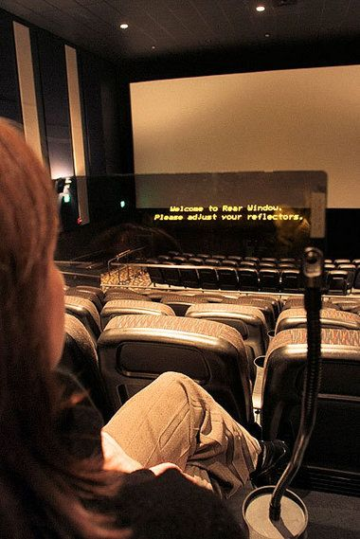
Captioning allows students to be included, to learn and understand just like everyone else.

Slide 16
Thank you!
Armin Safizadeh, 315-731- 5774 – IT Department: AB 137A asafizadeh@mvcc.edu
Jocelyn Ireland, 315-792-5372- Learning Commons IT 129 jireland@mvcc.edu
Tamara Mariotti, 315-731-5702- Accessibility Resources, PH104H tmariotti@mvcc.edu
Deb Otis, 315-792-5551 Educational Technologies, IT 140
dotis@mvcc.edu

